Slide 1


Foundations of
Scientific Computing
(SciComp 101)
Dave Biersach
dbiersach@bnl.gov
Session 06
Infinite Series and Limits

Slide 2
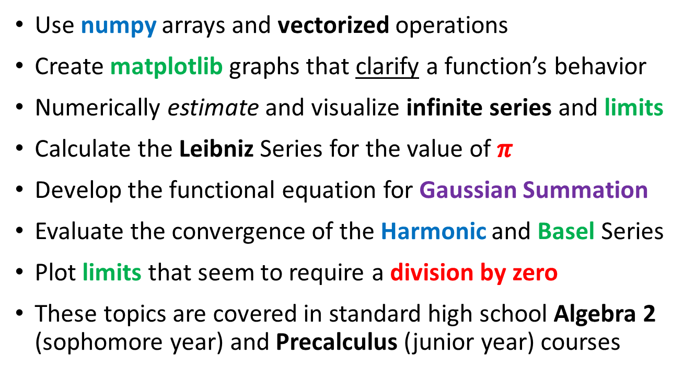
Session 06 – Goals
Use numpy arrays and vectorized operations
Create matplotlib graphs that clarify a function’s behavior
Numerically estimate and visualize infinite series and limits
Calculate the Leibniz Series for the value of $π$
Develop the functional equation for Gaussian Summation
Evaluate the convergence of the Harmonic and Basel Series
Plot limits that seem to require a division by zero
These topics are covered in standard high school Algebra 2 (sophomore year) and Precalculus (junior year) courses

Slide 3
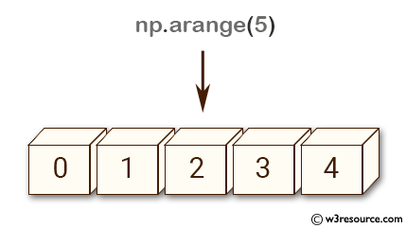
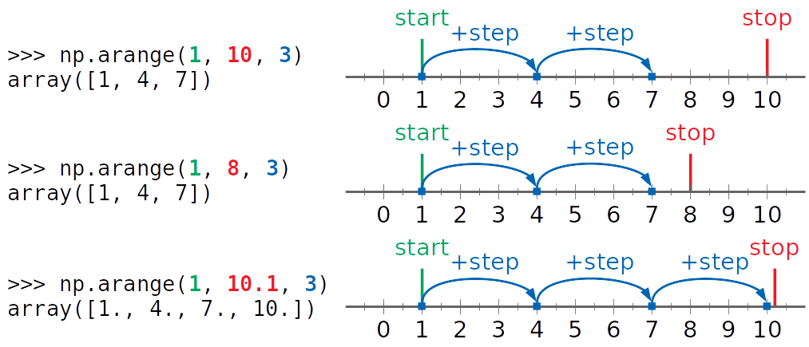
A Numpy Array from a Range
For np.arange()
the default start value is 0 and the default step value is 1, and the stop value is exclusive
Creates a "street" of mailboxes where the value inside each mailbox follows the requested range

Slide 4
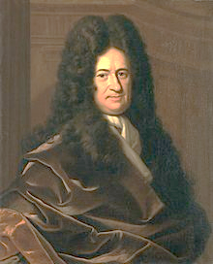



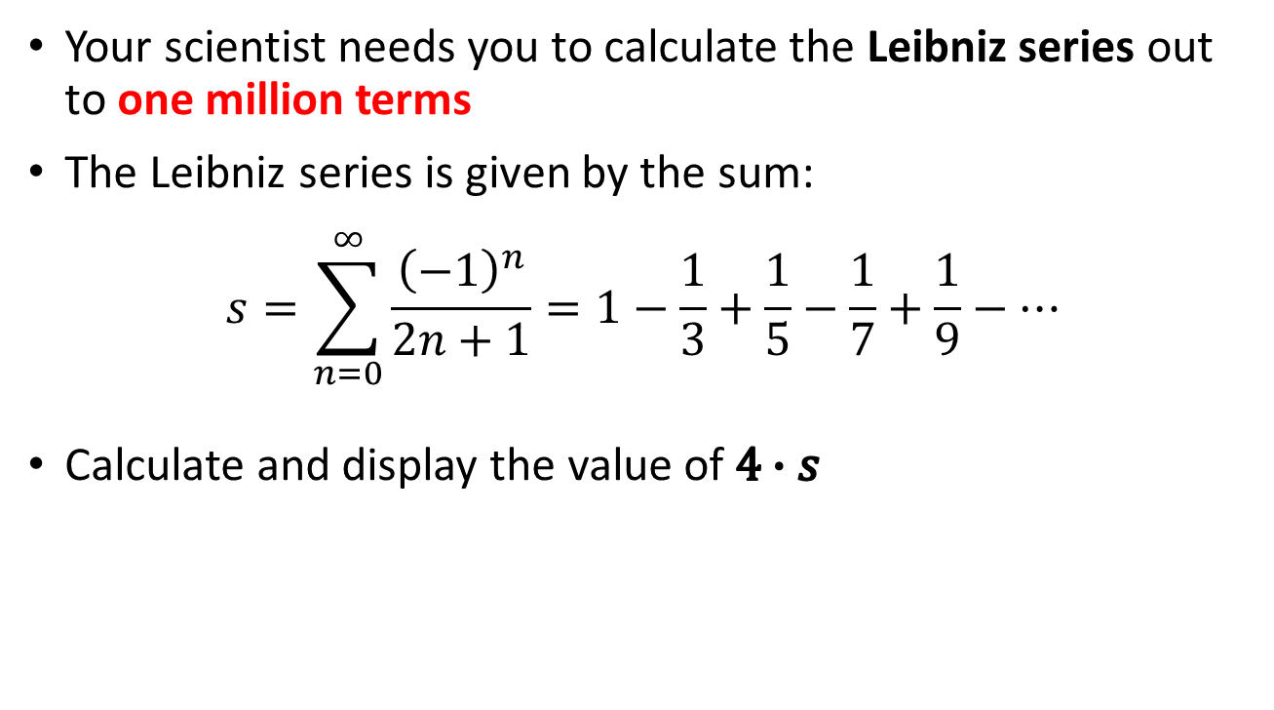



The Leibniz Series
Your scientist needs you to calculate the Leibniz series out to one million terms
The Leibniz series is given by the sum:
$$s=\sum_{n=0}^{∞}{\frac{{\left(−1\right)}^{n}}{2n+1}=1−\frac{1}{3}+\frac{1}{5}−\frac{1}{7}+\frac{1}{9}−⋯}$$
Calculate and display the value of $4∙s$
$$n=1$$
$$n=3$$
$$n=∞$$
$$n=0$$
$$n=2$$
$$n=4$$
Gottfried Wilhelm Leibniz
(1646-1716)

Slide 5
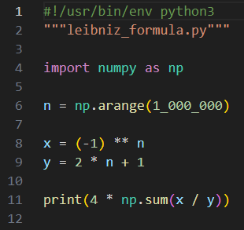
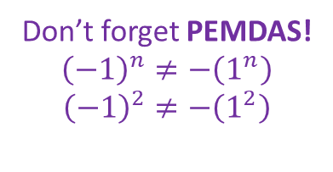
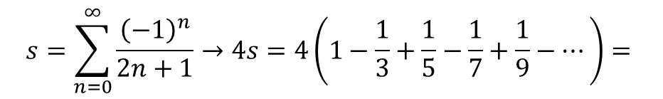
Edit leibniz_formula.py
You must type in this code
It is optional to separate the thousandths with underscores, but it does help a human read the number
①
②
n is an array, so now x is an array too!
Don’t forget PEMDAS!
$${\left(−1\right)}^{n}≠−\left(1^{n}\right)$$
$${\left(−1\right)}^{2}≠−\left(1^{2}\right)$$
③
④
y also has 1M items!
⑤
$$s=\sum_{n=0}^{∞}{\frac{{\left(−1\right)}^{n}}{2n+1}→4s=4\left(1−\frac{1}{3}+\frac{1}{5}−\frac{1}{7}+\frac{1}{9}−⋯\right)}=$$

Slide 6
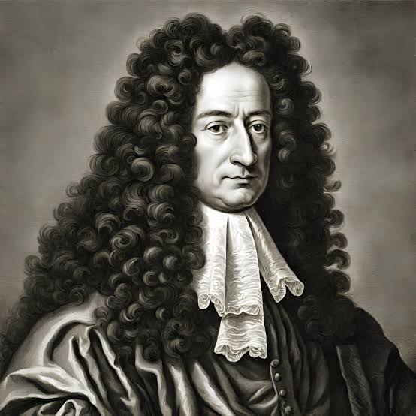
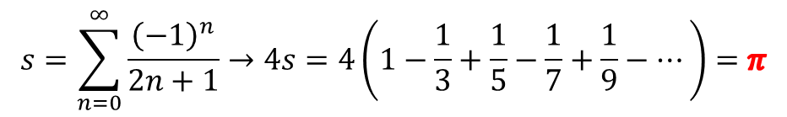
Run leibniz_formula.py
Gottfried Wilhelm Leibniz
(1646-1716)
①
$$s=\sum_{n=0}^{∞}{\frac{{\left(−1\right)}^{n}}{2n+1}→4s=4\left(1−\frac{1}{3}+\frac{1}{5}−\frac{1}{7}+\frac{1}{9}−⋯\right)}=π$$
Leibniz, 1673 (27 years old)

Slide 7
Gaussian Summation
Carl Friedrich Gauss (1777-1855) is widely considered to be the most impactful mathematician who has ever lived
He didn’t just solve problems; he created or reshaped entire fields:
Number Theory (Congruence, Quadratic Reciprocity)
Complex Analysis (Fundamental Theorem of Algebra, FFT)
Linear Algebra (Gaussian Elimination, PCA)
Probability & Statistics (Normal distribution, CLT)
Physics & Electromagnetism (Gauss’s Law, Flux/Divergence)
Astronomy & Geodesy (Method of Least Squares)
Differential Geometry (Gaussian Curvature)

Slide 8
Gaussian Summation
One spring day, when Gauss was 11 years old, he was sitting in his elementary school class. His classmates were misbehaving, so his schoolteacher thought of a task she hoped would teach the students a lesson in self-control while simultaneously reinforcing their basic addition skills
She said they could not play outside during recess until one of them had summed the natural numbers up to 100. She assumed this task would take quite some time. The students all grumbled and pulled out their chalk slates to start the arduous process of adding together each successive integer
The young Gauss thought for just a moment and then immediately wrote down the correct answer, but never actually added up all the numbers. How did he do this?

Slide 9
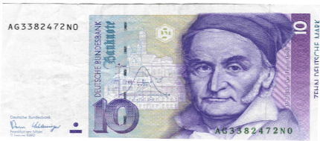

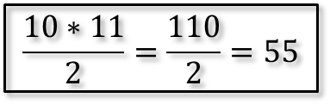
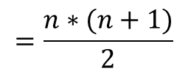
Gaussian Summation
Carl Friedrich Gauss
(1777 – 1855)
Sum the integers from 1 to 10
1
2
3
4
5
6
7
8
9
10
1 | 9
2 | 8
3 | 7
4 | 6
5
10
4 matched rows that each sum to 10
10 / 2 = 5 5 – 1 = 4 10 * 4 = 40
1 row that is = 10 / 2 = 5
$$\frac{10∗11}{2}=\frac{110}{2}=55$$
1 row that is = n = 10
$$=\frac{n∗(n+1)}{2}$$
= (40 + 5 + 10) = 55

Slide 10


Gaussian Summation
Sum of first n
natural numbers:
Sum of squares of first n natural numbers:
n | n^2 | Sum
1 | 1 | 1
2 | 4 | 5
3 | 9 | 14
4 | 16 | 30
5 | 25 | 55
6 | 36 | 91
7 | 49 | 140
8 | 64 | 204
9 | 81 | 285
10 | 100 | 385
These are functional equations
We can now calculate the sums
immediately without having to loop over every element!

Slide 11
Gaussian Summation
Your scientist needs you to demonstrate the equivalence of the Gaussian functional equation for summation versus the manual approach of term-by-term summation
Calculate the cumulative sum series of the first 10 natural numbers and show, term-by-term, the equivalence of these partial sums compared to the corresponding Gaussian summation values

Slide 12
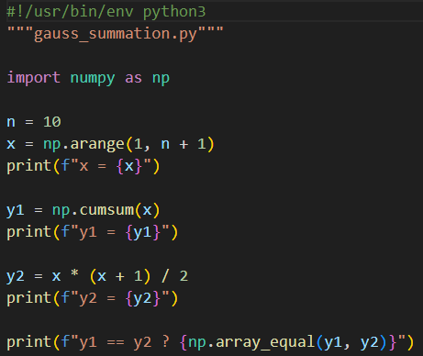
Open gauss_summation.py
You must type in this code
①
②
③
④
Returns an array of the partial sums
⑤
⑥
y2 is now an array with 10 items
⑦
⑧
⑨

Slide 13

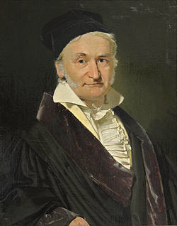
Run gauss_summation.py
What is the sum of the first 300 quadrillion natural numbers?
The naïve way would take 7.4 years to find the answer on a fast PC!
Carl Friedrich Gauss
(1777-1855)

Slide 14
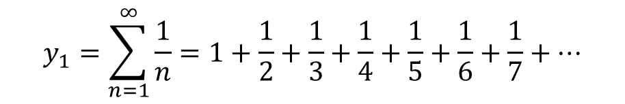
Infinite Series (Sums)
$$y_{1}=\sum_{n=1}^{∞}{\frac{1}{n}=1+\frac{1}{2}+\frac{1}{3}+\frac{1}{4}+\frac{1}{5}+\frac{1}{6}+\frac{1}{7}+…}$$
This sum is called the Harmonic series
Does this series converge to a single value or diverge (grow without bounds)?

Slide 15
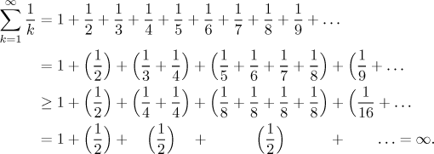
The Harmonic Series Diverges

Slide 16
The Harmonic Series Diverges

Slide 17
The Harmonic Series Diverges

Slide 18
The Harmonic Series Diverges

Slide 19
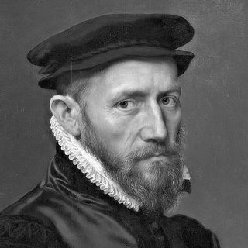
The Harmonic Series Diverges
The harmonic series diverges
Nicole Oresme (c. 1360)

Slide 20
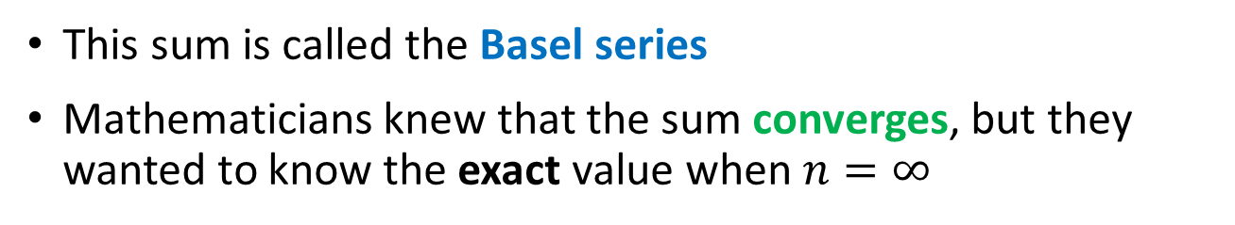
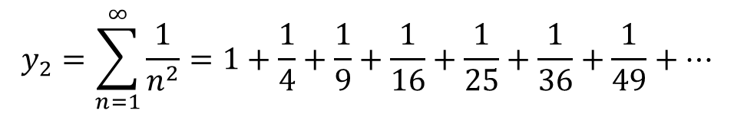
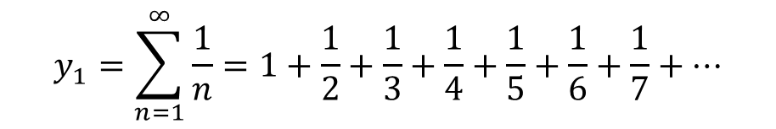
Infinite Series (Sums)
$$y_{1}=\sum_{n=1}^{∞}{\frac{1}{n}=1+\frac{1}{2}+\frac{1}{3}+\frac{1}{4}+\frac{1}{5}+\frac{1}{6}+\frac{1}{7}+…}$$
This sum is called the Harmonic series
Oresme proved that the sum diverges
$$y_{2}=\sum_{n=1}^{∞}{\frac{1}{n^{2}}=1+\frac{1}{4}+\frac{1}{9}+\frac{1}{16}+\frac{1}{25}+\frac{1}{36}+\frac{1}{49}+…}$$
This sum is called the Basel series
Mathematicians knew that the sum converges, but they wanted to know the exact value when $n=∞$

Slide 21
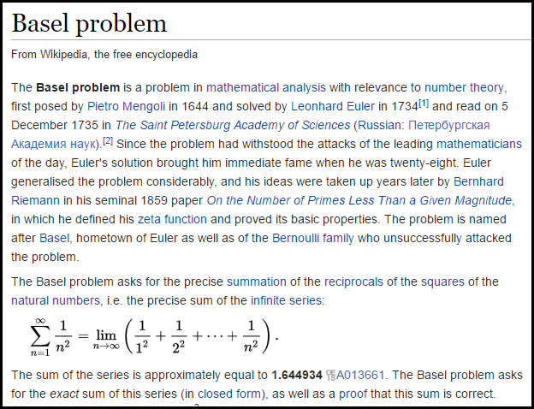

Slide 22
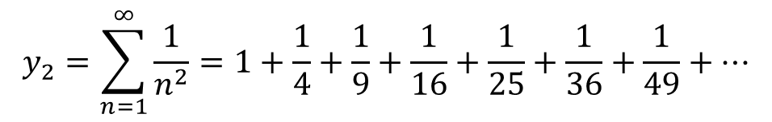
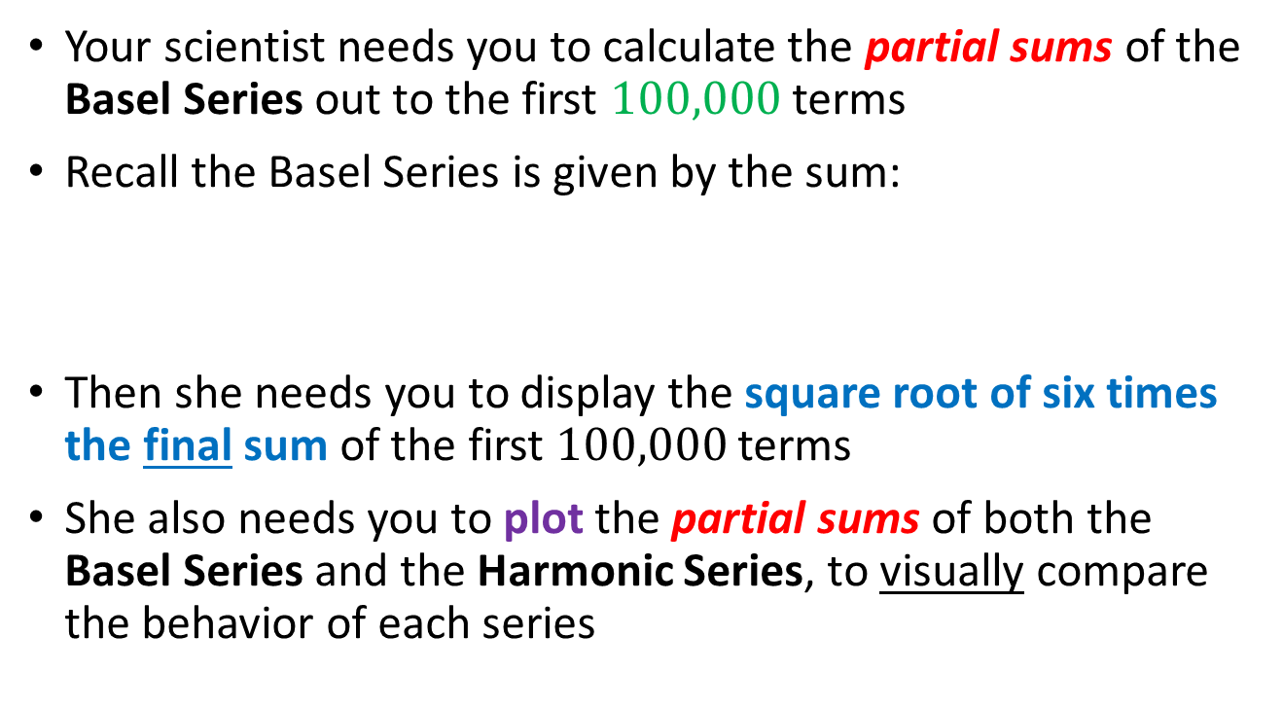
The Basel Problem
Your scientist needs you to calculate the partial sums of the Basel Series out to the first $100,000$ terms
Recall the Basel Series is given by the sum:
Then she needs you to display the square root of six times the final sum of the first $100,000$ terms
She also needs you to plot the partial sums of both the Basel Series and the Harmonic Series, to visually compare the behavior of each series
$$y_{2}=\sum_{n=1}^{∞}{\frac{1}{n^{2}}=1+\frac{1}{4}+\frac{1}{9}+\frac{1}{16}+\frac{1}{25}+\frac{1}{36}+\frac{1}{49}+…}$$

Slide 23
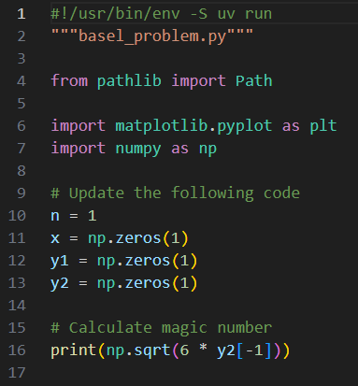
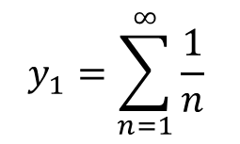
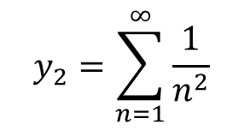
Open basel_problem.py
$$y_{1}=\sum_{n=1}^{∞}{\frac{1}{n}}$$
This is NOT what your scientists wanted
$$y_{2}=\sum_{n=1}^{∞}{\frac{1}{n^{2}}}$$

Slide 24
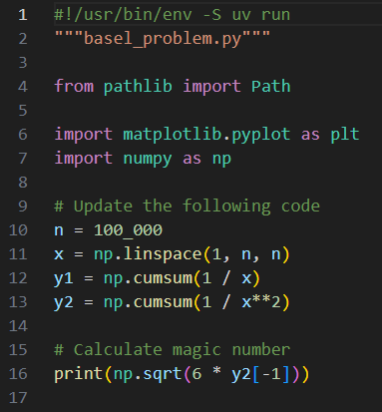
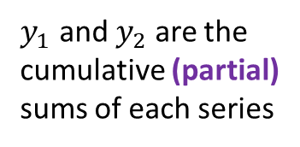
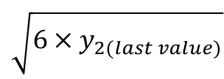

Edit basel_problem.py
You must type in this code
$$y_{1}=\sum_{n=1}^{∞}{\frac{1}{n}}$$
①
$$n→100,000$$
②
$y_{1}$ and $y_{2}$ are the cumulative (partial) sums of each series
③
$$y_{2}=\sum_{n=1}^{∞}{\frac{1}{n^{2}}}$$
$$\sqrt{{6×y}_{2(last value)}}$$
④

Slide 25
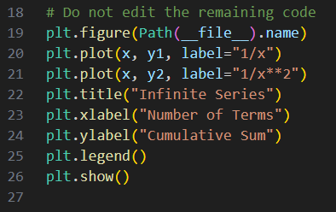
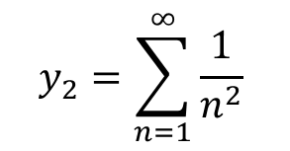
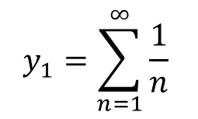
View basel_problem.py
$$y_{1}=\sum_{n=1}^{∞}{\frac{1}{n}}$$
①
②
$$y_{2}=\sum_{n=1}^{∞}{\frac{1}{n^{2}}}$$
③
④
⑤

Slide 26
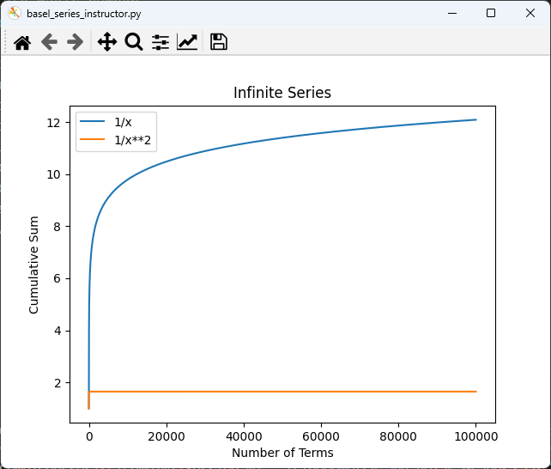
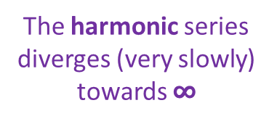


Run basel_problem.py
The harmonic series diverges (very slowly) towards $∞$
$$y_{2}=\sum_{n=1}^{∞}{\frac{1}{n^{2}}}$$
$$\sqrt{6∙y_{2}}=$$
The Basel series converges to a specific number

Slide 27
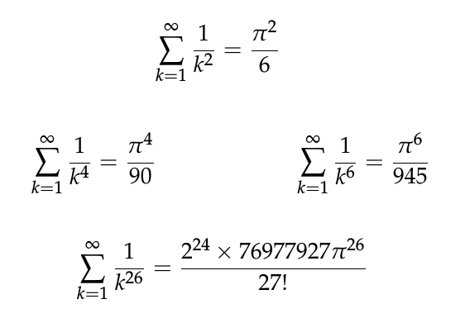
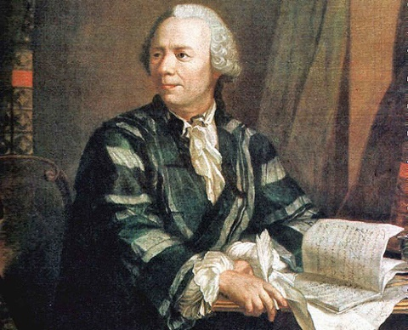
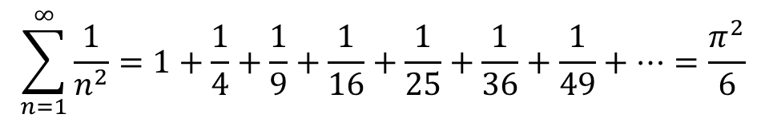
The Basel Problem
$$\sum_{n=1}^{∞}{\frac{1}{n^{2}}=1+\frac{1}{4}+\frac{1}{9}+\frac{1}{16}+\frac{1}{25}+\frac{1}{36}+\frac{1}{49}+…}=\frac{π^{2}}{6}$$
Euler proved this in 1734 when he was 27 years old
YouTube - 3Blue1Brown
YouTube - ZetaMath
Only even exponents ☹
Leonhard Euler
(1707 – 1783)

Slide 28
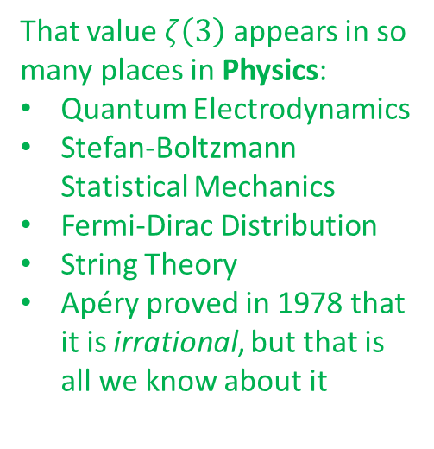

The Basel Problem
$$\sum_{n=1}^{∞}{\frac{1}{n^{2}}=1+\frac{1}{4}+\frac{1}{9}+\frac{1}{16}+\frac{1}{25}+\frac{1}{36}+\frac{1}{49}+…}=\frac{π^{2}}{6}$$
Euler proved this in 1734 when he was 27 years old
YouTube - 3Blue1Brown
YouTube - ZetaMath
But 292 years later,
we still do not know
the exact value of
That value $ζ\left(3\right)$ appears in so many places in Physics:
Quantum Electrodynamics
Stefan-Boltzmann Statistical Mechanics
Fermi-Dirac Distribution
String Theory
Apéry proved in 1978 that it is irrational, but that is all we know about it
$$ζ\left(3\right)=\sum_{k=1}^{∞}{\frac{1}{k^{3}}}$$
Leonhard Euler
(1707 – 1783)
Or any odd exponents ☹

Slide 29
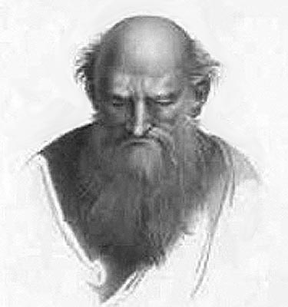
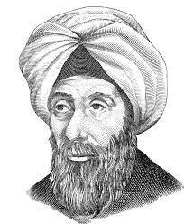
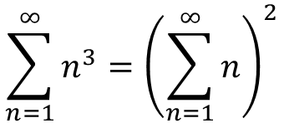
Impress Me
Demonstrate in Python that the sum of the cubes of the natural numbers equals the square of the sum of the natural numbers
$$\sum_{n=1}^{∞}{n^{3}}={\left(\sum_{n=1}^{∞}{n}\right)}^{2}$$
Nicomachus of Gerasa
(AD 60-120)
Al-Karaji
(953–1029 AD)
Al-Karaji proved this in 1000 AD
It’s 2026 – can you prove this?

Slide 30
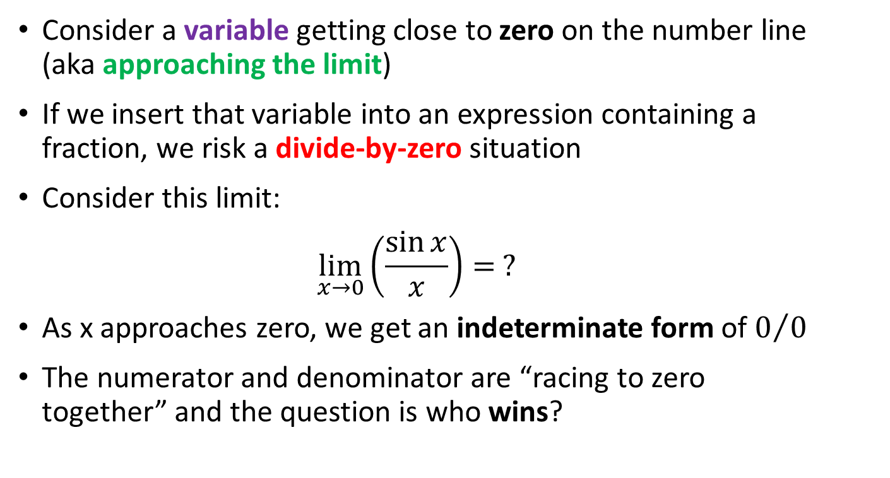
Indeterminate Limits
Consider a variable getting close to zero on the number line (aka approaching the limit)
If we insert that variable into an expression containing a fraction, we risk a divide-by-zero situation
Consider this limit:
$$\lim_{x→0}\left(\frac{\sin{x}}{x}\right)= ?$$
As x approaches zero, we get an indeterminate form of $0/0$
The numerator and denominator are “racing to zero together” and the question is who wins?

Slide 31
Indeterminate Limits
In 1691, Guillaume François Antoine, Marquis de L'Hôpital (1661-1704) hired Johann Bernoulli, a brilliant young Swiss mathematician, as his private tutor
L'Hôpital proposed that Bernoulli teach L'Hôpital about calculus, and L'Hôpital would not publish Bernoulli’s work. Bernoulli, who at the time needed money, agreed
In 1696, L’Hôpital published Analysis of the Infinitely Small for the Understanding of Curved Lines, which was the first textbook on differential calculus
That book contained Bernoulli’s original technique for evaluating indeterminate limits. Unfortunately, this is now called L'Hôpital’s Rule (verified in 1922)

Slide 32

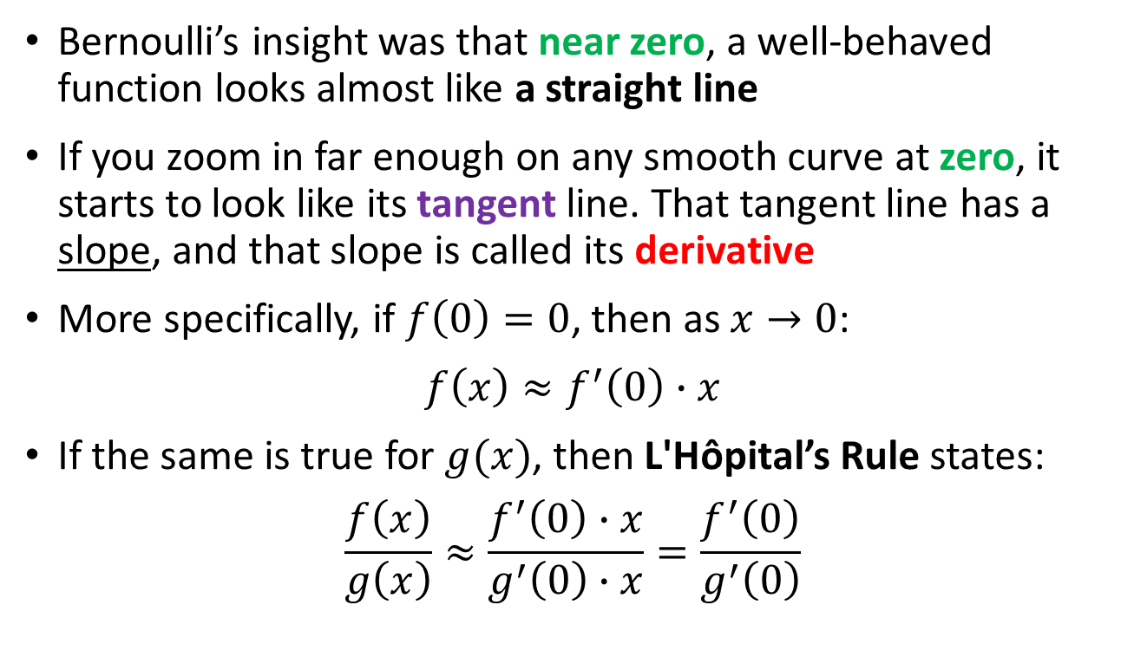

Indeterminate Limits
Bernoulli’s insight was that near zero, a well-behaved function looks almost like a straight line
If you zoom in far enough on any smooth curve at zero, it starts to look like its tangent line. That tangent line has a slope, and that slope is called its derivative
More specifically, if $f\left(0\right)=0$, then as $x→0$:
$$f\left(x\right)≈f^{′}\left(0\right)∙x$$
If the same is true for $g(x)$, then L'Hôpital’s Rule states:
$$\frac{f\left(x\right)}{g\left(x\right)}≈\frac{f^{′}\left(0\right)∙x}{g^{′}\left(0\right)∙x}=\frac{f^{′}\left(0\right)}{g^{′}\left(0\right)}$$
$$slope=\frac{rise}{run}$$
$$rise=slope∙run$$

Slide 33

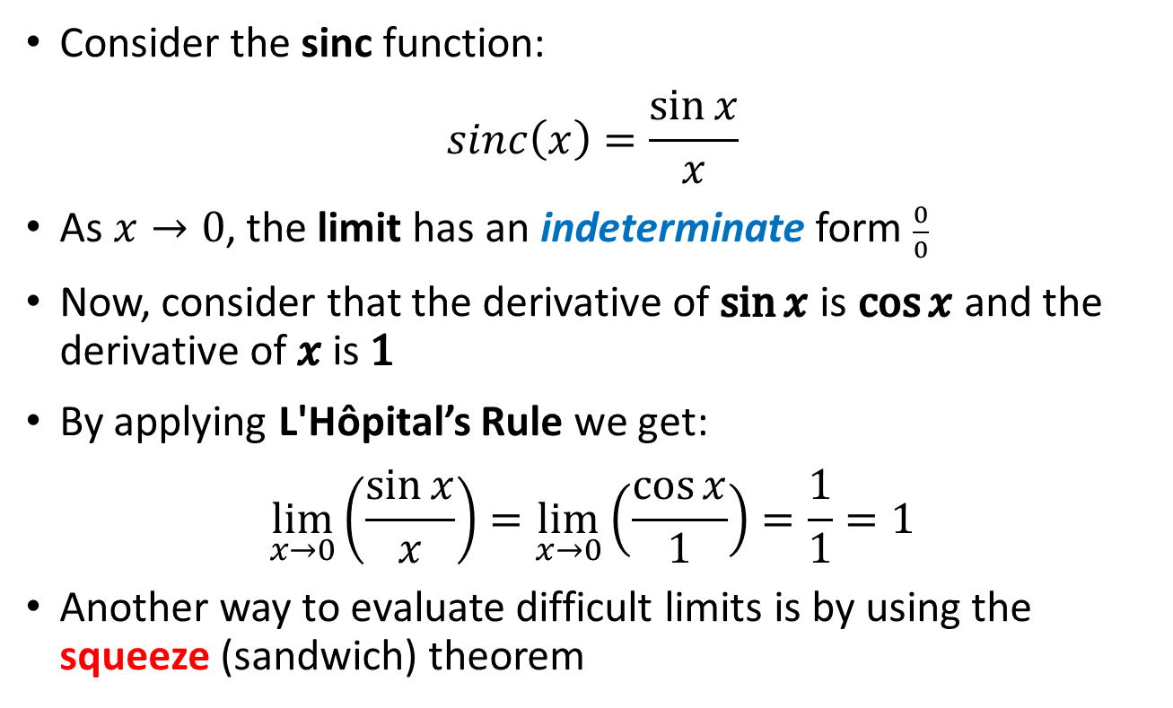

Indeterminate Limits
Consider the sinc function:
$$sinc\left(x\right)=\frac{\sin{x}}{x}$$
As $x→0$, the limit has an indeterminate form $\frac{0}{0}$
Now, consider that the derivative of $\sin{x}$ is $\cos{x}$and the derivative of $x$ is $1$
By applying L'Hôpital’s Rule we get:
$$\lim_{x→0}\left(\frac{\sin{x}}{x}\right)=\lim_{x→0}\left(\frac{\cos{x}}{1}\right)=\frac{1}{1}=1$$
Another way to evaluate difficult limits is by using the squeeze (sandwich) theorem
$$\frac{f\left(x\right)=\sin{x}}{g\left(x\right)=x}$$
$$\frac{f\left(x\right)}{g\left(x\right)}=\frac{f′\left(x\right)}{g′\left(x\right)}$$

Slide 34
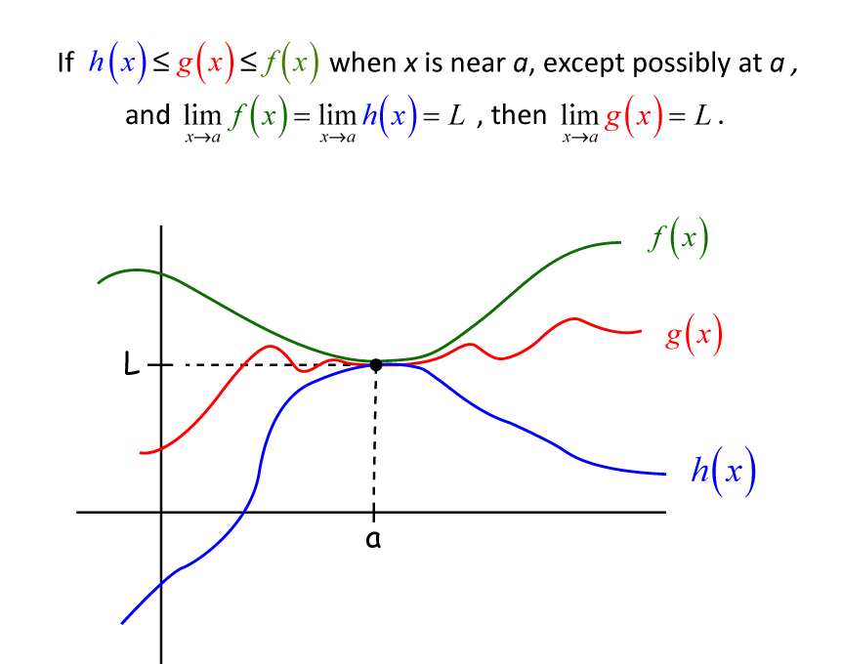
The Squeeze Theorem
Aka the sandwich theorem

Slide 35
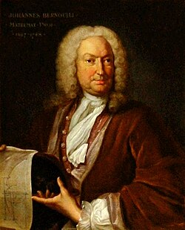
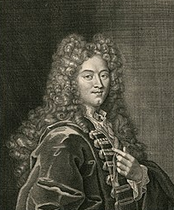
Indeterminate Limits
You will cover all these topics in your high school precalculus and calculus courses
For now, we will just plot each function and observe the value of the function (the limit) at the critical value
However, graphing provides only a qualitative assessment, not a quantitative proof
Guillaume de L'Hôpital
(1667-1748)
Johann Bernoulli
(1667-1748)

Slide 36



Open limit_sinc.py
DO NOT edit
this code
①
Using an even number of intervals over the span
$−4π≤x≤4π$ avoids $x=0$
②
The $sinc\left(x\right)$ function
③
④
⑤
r = red color, o = circle marker

Slide 37


View limit_sinc.py
①
Find successive differences between adjacent terms
②

Slide 38
View limit_sinc.py
①
Find successive differences between adjacent terms
②
③
Boolean Indexing on y array
④
⑤
⑥
⑦
⑧
⑨
g = green color, o = circle marker
⑩

Slide 39

View limit_sinc.py
①
②
③
④
An array of two 0 values for y coordinates
⑤
g = black color, o = circle marker
⑥
LaTeX \pm = plus-minus symbol

Slide 40

View limit_sinc.py
①
②
③
Give “room” on top & bottom
④
⑤
⑥
⑦
⑧

Slide 41

Run limit_sinc.py
There is no analytic (closed-form) solution – we can only numerically estimate this!

Slide 42


Why $sinc(x)$ has no analytic global minimum?
$$f\left(x\right)=sinc\left(x\right)=\frac{\sin{x}}{x}=\sin\left(x\right)∙x^{−1}$$
$${\left[u∙v\right]}^{′}=u∙v^{′}+v∙u^{′}$$
where $u=\sin{x}$ and $v=x^{−1}$
$u^{′}=\cos{x}$ and $v^{′}=−x^{−2}$
$$f^{′}\left(x\right)=\left(\sin{x}\right)\left(−x^{−2}\right)+\left(x^{−1}\right)\left(\cos{x}\right)$$
$${sinc}^{′}\left(x\right)=\frac{x\cos{x}−\sin{x}}{x^{2}}$$

Slide 43

Why $sinc(x)$ has no analytic global minimum?
$${sinc}^{′}\left(x\right)=\frac{x\cos{x}−\sin{x}}{x^{2}}$$
$$\frac{x\cos{x}−\sin{x}}{x^{2}}=0$$
$$x\cos{x}−\sin{x}=0$$
$$x\cos{x}=\sin{x}$$
$$x=\frac{\sin{x}}{\cos{x}}=\tan{x}$$
$$\tan{x}=x$$
Spherical Bessel function of the first kind
This is a transcendental equation

Slide 44


Why $sinc(x)$ has no analytic global minimum?

Slide 45

Indeterminate Limits
Here is an interesting limit:
$$\lim_{x→0}{{\left(1+x\right)}^{\left(\frac{1}{x}\right)}}$$
What do you anticipate the limit will be?
What happens if you plug in $x=0$ into the limit?
$$\lim_{x→0}{{\left(1\right)}^{\left(\frac{1}{0}\right)}}$$
What about $x=−1→\lim_{x→−1}{{\left(1+\left(−1\right)\right)}^{\left(\frac{1}{−1}\right)}}→0^{−1}$
What about $x=−2→\lim_{x→−2}{{\left(1+\left(−2\right)\right)}^{\left(\frac{1}{−2}\right)}}→\frac{1}{\sqrt{−1}}$
Divide by zero
Divide by zero
Imaginary

Slide 46

Open limit_exp.py
DO NOT edit
this code
①
②
③

Slide 47

Run limit_exp.py

Slide 48


Limit definition of $e$
Recall that L'Hôpital’s Rule only applies to ratios, not exponential forms, which is what we have here:
$$L=\lim_{x→0}{{\left(1+x\right)}^{\left(\frac{1}{x}\right)}}$$
But if we take the log of both sides, we get a ratio:
$$\ln\left(L\right)=\lim_{x→0}\left(\ln\left({\left(1+x\right)}^{\left(\frac{1}{x}\right)}\right)\right)=\lim_{x→0}\left(\frac{\ln\left(x+1\right)}{x}\right)$$
Taking the derivative of numerator and denominator:
$$\ln\left(L\right)=\lim_{x→0}\left(\frac{\frac{1}{1+x}}{1}\right)=1→L=e$$
As we saw in the plot of limit_exp.py

Slide 49

Indeterminate Limits
What about this limit:
$$\lim_{x→0}{\frac{\left(e^{x}−1\right)}{x}}= ?$$
What happens when $x=0$ ?
What do you anticipate the limit will be?
What is the derivative of $e^{x}$ ?

Slide 50



Open limit_d_exp.py
DO NOT edit
this code
①
②
$$y=\left(e^{x}−1\right)/x$$
③
b = blue color, - = solid line
④
Plot a single $\left(x,y\right)$ coordinate at $\left(0,1\right)$

Slide 51


Run limit_d_exp.py
The slope of $e^{x}$ at the origin is exactly 1, which is one of the special properties that makes $e$ the “natural” base for exponents

Slide 52

Indeterminate Limits
What about this limit:
$$\lim_{x→∞}{\sqrt{x^{2}+x}−x}= ?$$
Here we are taking the limit as x goes to infinity
What do you anticipate the limit will be?
This is an indeterminate form that L'Hôpital’s Rule can not handle directly
We must transform it first
For those with Algebra 2 experience, think about multiplying a polynomial by its conjugate

Slide 53









Indeterminate Limits
$$\sqrt{x^{2}+x}−x=\left(\sqrt{x^{2}+x}−x\right)×\frac{\left(\sqrt{x^{2}+x}+x\right)}{\left(\sqrt{x^{2}+x}+x\right)}$$
Multiply by the conjugate
$$\sqrt{x^{2}+x}−x=\frac{\left(\sqrt{x^{2}+x}−x\right)\left(\sqrt{x^{2}+x}+x\right)}{\left(\sqrt{x^{2}+x}+x\right)}$$
Simplify
If $x>0$ we can use
$$\sqrt{x^{2}+x}−x=\frac{x}{\sqrt{x^{2}+x}+x}$$
$$\sqrt{x^{2}+x}=x\sqrt{1+1/x}$$
$$\sqrt{x^{2}+x}−x=\frac{x}{x\sqrt{1+1/x}+x}=\frac{1}{\sqrt{1+1/x}+1}$$
Substitute in the above identity and then factor out an $x$
$$\frac{1}{∞}=0$$
$$\lim_{x→∞}{\frac{1}{\sqrt{1+1/x}+1}}=\frac{1}{\sqrt{1}+1}=\frac{1}{2}$$
Substitute in the limit

Slide 54


Open limit_conjugate.py
DO NOT edit
this code
①
$$\lim_{x→∞}{\sqrt{x^{2}+x}−x}$$
②
③
④

Slide 55


Run limit_conjugate.py
$$\lim_{x→∞}{\sqrt{x^{2}+x}−x}=\frac{1}{2}$$
A conjugate limit
A rationalization limit
A radical difference limit
A square root asymptotic correction

Slide 56

A Final Limit
What about this limit:
$$\lim_{n→∞}{\frac{\sum{n}}{n^{2}}}= ?$$
Here we are taking the limit as $n$ goes to infinity
What do you anticipate the limit will be?
This is an indeterminate form that L'Hôpital’s Rule can not handle directly because the numerator is a discrete function, not a continuous differentiable one
First, let’s plot the limit to see how it performs
Then, let’s think about how we could transform it in order to develop a formal proof of the limit value

Slide 57

Open limit_gaussian_sum.py
DO NOT edit
this code
④
⑤
⑥
①
②
③

Slide 58


View limit_gaussian_sum.py
①
②
③
④
⑤
⑥

Slide 59

Run limit_gaussian_sum.py
①

Slide 60







Proving a Limit
$$=\lim_{n→∞}{\frac{\frac{n\left(n+1\right)}{2}}{n^{2}}}$$
$$\lim_{n→∞}{\frac{\sum{n}}{n^{2}}}$$
$$=\frac{1}{2}\lim_{n→∞}{\frac{n^{2}+n}{n^{2}}}$$
$$=\frac{1}{2}\lim_{n→∞}\left(1+\frac{1}{n}\right)$$
$$\frac{1}{∞}=0$$
$$=\frac{1}{2}\left(1+0\right)=\frac{1}{2}$$
☑

Slide 61

Session 06 – Now You Know…
Techniques for decorating your matplotlib graphs to draw the reader’s attention to important areas in the function
How to numerically estimate and visualize infinite series and limits
How to calculate the Leibniz Series for the value of $π$
The history and value of Gaussian Summation
That some series diverge (Harmonic) while some series converge (Basel)
L'Hôpital’s Rule allows us to find limits that otherwise might require division by zero

Slide 62

Task 06
Your scientist needs you to calculate this sum:
$$s=\sum_{k=1}^{30}{\frac{1}{2^{k}k}}$$
Notice the bounds of the summation are 1 and 30 inclusive
Then calculate and print this value: $e^{s}$

